Slide 1
DIVERSITY POWERPOINT
2021 LEADERSHIP WORKSHOP
OCT 31-NOV 2, 2021

Slide 2
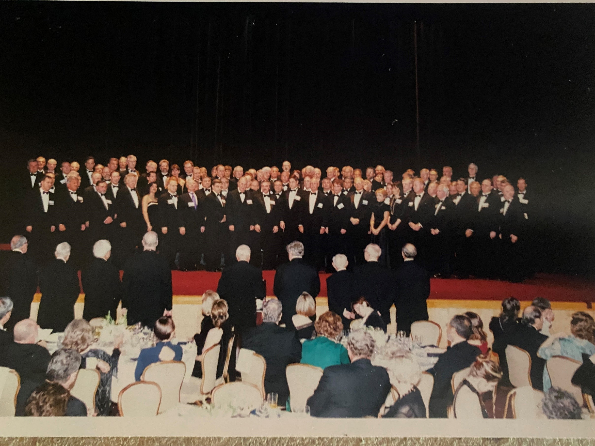

Slide 3
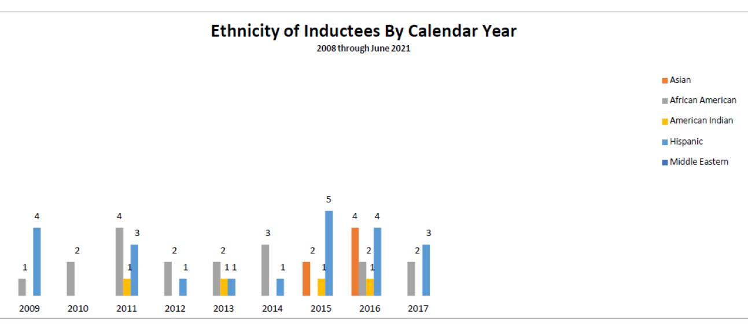

Slide 6
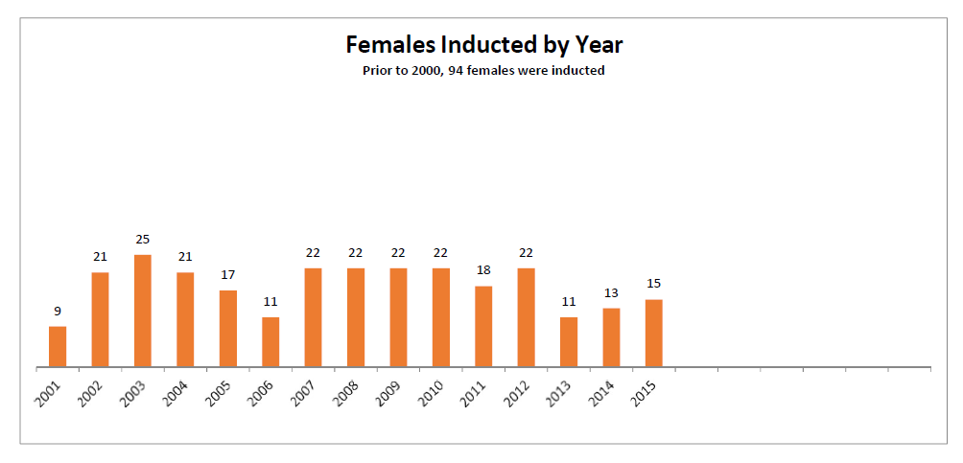

Slide 8
ACTL Statement on Diversity
Consistent with its Mission Statement, the College seeks to promote the treatment of every person with dignity and respect, and to foster an inclusive, collegial environment that values the unique background, experiences, perspectives, and contributions of all. Under a singular standard of excellence that values and appreciates differences in its membership, the College endeavors to identify talented and accomplished trial lawyers as possible Fellows, including women and persons of color, varying ethnicities, disabilities and sexual orientation.

Slide 9
Confer with:
Local, state and province minority bar associations for outstanding trial lawyers;
National minority bar associations, like National Bar, Hispanic Bar, South Asian Bar;
State/Province Bar Associations
Consider candidates from government:
Federal, state/province district and crown attorneys, public defenders, city, JAGC;
Confer with Judges to ask who they think are the best trial lawyers;
Consider other practices like:
Family law, personal injury, criminal law, civil rights litigation;
Consider those diverse trial lawyers who are already members of other groups like:
International Academy of Trial Lawyers
International Society of Barristers
ABOTA
Identify lawyers who are currently second chair to put on a “watch list”;
Require each State/Province Committee to designate a Diversity Liaison to aid the search.

Slide 10
And last year, in his Annual Report, our President Rodney Acker said the following:
The College has made progress in its attempt to diversify the Fellowship. In the September 2020 Board of Regents’ Meeting, 35% of the nominees that were approved for Fellowship were diverse because of gender, color, or ethnicity. [updated 2021 Annual Board Meeting: 41%] For the combined 2020 Spring and Annual meetings of the Board, that percentage was 27%. [updated 2021 combined Board meetings: 44%] The percentage of diverse Fellows for the College as a whole is 12%. [updated Oct 2021:13%]
To become a “…Fellowship of exceptional trial lawyers of diverse backgrounds…” as described in our Mission Statement, we need to do more, and we are doing more. On the website, the College has posted its “Action and Implementation of The College Diversity Statement” identifying seven ways the State and Province Committees should broaden their searches for diverse candidates, and eight Implementation Recommendations to identify and implement our diversity efforts.

Slide 11
Confer with:
Local, state and province minority bar associations for outstanding trial lawyers;
National minority bar associations, like National Bar, Hispanic Bar, South Asian Bar;
State/Province Bar Associations
Consider candidates from government:
Federal, state/province district and crown attorneys, public defenders, city, JAGC;
Confer with Judges to ask who they think are the best trial lawyers;
Consider other practices like:
Family law, personal injury, criminal law, civil rights litigation;
Consider those diverse trial lawyers who are already members of other groups like:
International Academy of Trial Lawyers
International Society of Barristers
ABOTA
Identify lawyers who are currently second chair to put on a “watch list”;
Require each State/Province Committee to designate a Diversity Liaison to aid the search.

Slide 12
Why do you think that there are not more diverse Fellows participating on ACTL committees?
I don’t understand the role or importance of the committees to the College.
Many, like myself, do not know the process to become a committee member.

Slide 13
Why do you think that more diverse Fellows do not attend Fall and Spring meetings?
They are so large with so many people. I think the emphasis should be on having more local events so that you know more people when you go to national events.
Given age and racial differences, I feel that I have little in common with other Fellows, other than the College itself.
Particularly for younger Fellows with young children like me, it is difficult to travel to expensive venues and to leave the children at home. Older Fellows seem to do that with ease.
Diverse Fellows from small firms do not have the luxury of a big firm to reimburse the expenses of a national College meeting.
From my ABA experience, I found that simply having some organizational role, like service on a committee, provides a psychological incentive for people to attend meetings.

Slide 14
Should newly-admitted Fellows, whether diverse or not, have mentors assigned to integrate them into the College?
Excellent idea, as long as it applies to all Fellows, not just diverse Fellows.
I do think a Fellow should be assigned to integrate newly-admitted Fellows into the College.

Slide 15
As Fellows of color, what do you think the College should do, if anything, to make the national meetings more inviting?
The subject matter and content of the meetings are not the problem because they are always interesting and informative. It is the awkwardness that comes from being one of so few who look like me. The College should continue to admit more Fellows of color.
I am hesitant to approach non-diverse Fellows when there are so few diverse Fellows attending. Having more Fellows of color makes me feel less isolated.
The College leadership should reach out to diverse Fellows directly to help them feel welcomed. I try hard to meet non-diverse Fellows, but I don’t feel non-diverse Fellows are trying as hard as I am to meet me.
As a diverse Fellow, I am always pleased to see a diverse speaker at the microphone. I would welcome more.

Slide 16
What else do you think might move the needle?
The national meetings are just too large to get to know people and make strong acquaintances. The College should promote more events on a local level with smaller groups.
The College should have diverse lawyers in high profile leadership positions to signal that the College welcomes diversity.

Slide 17
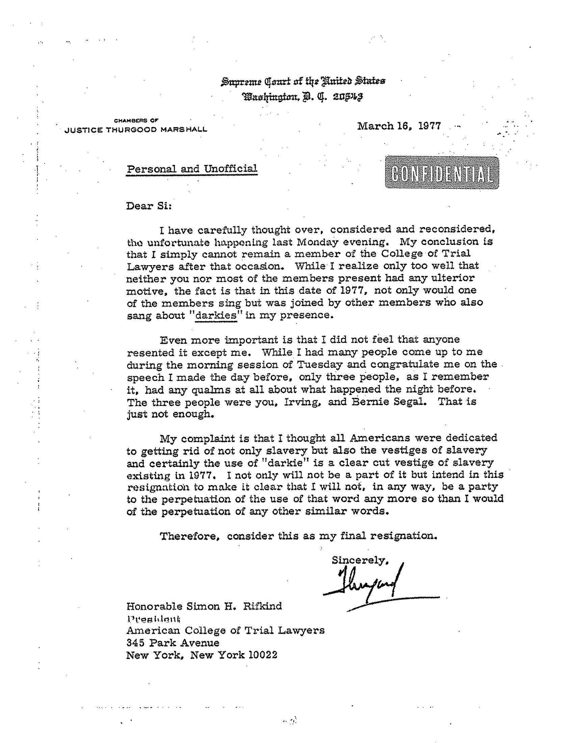

Slide 18
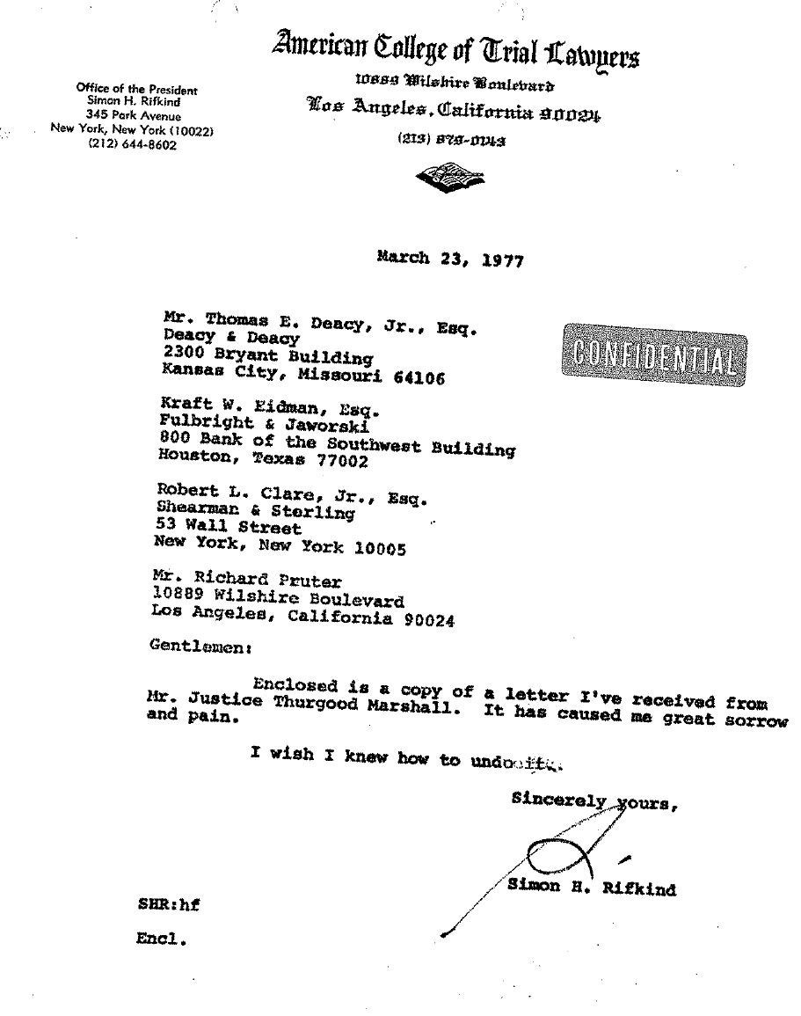

Slide 19
